Slide 1

- By Jai Katariya

Slide 2
Overview and Goals
Business Questions
Is the UX of my website user-friendly?
Is the mobile website helping traffic based on sessions and active users?
Which acquisition channels are working?
Cart abandonment rate.
What is the conversion rate of the store?
Notes:
→ Increasing Sessions? As sessions are the footfall.
→ The solo performance of mobile website? People are on the go and usage of mobile has increased so we are targeting mobile.

Slide 3
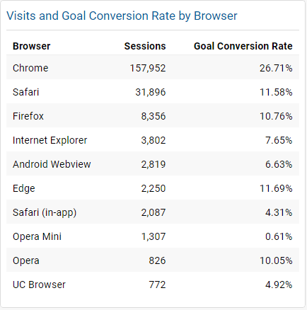
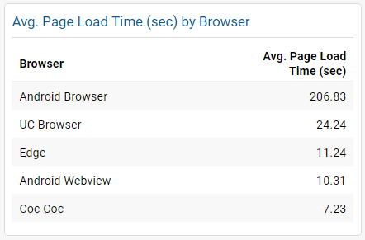
IT Dashboard
Recommendation
Work to make the website more responsive and reduce average load time specially for Android Browser.
High average load time could be an indicator why the browser does not show up in the top 10 browser sessions.
Business impact
More seamless browsing experience for users
Insights
Leaving Chrome, other browsers like Safari and Firefox are not only less popular among users, they also have lower conversion rates.
Android Browser is 10-20 times more then others in Average page load time in seconds.

Slide 4
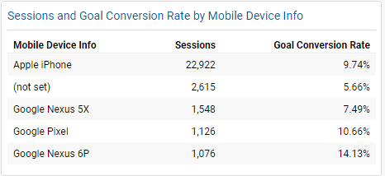
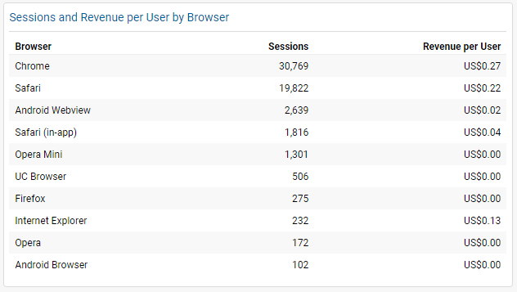
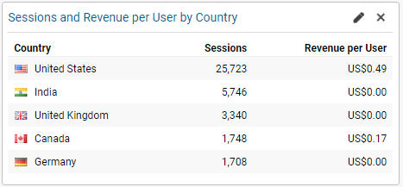
IT Dashboard – Mobile
Insights:
While the Apple iPhone has the highest sessions, it does not rank on the top for its conversion rate.
Countries like India have zero revenue per user in spite of high sessions, unlike Canada
Android webview has 1.5x more sessions but only 50% Revenue per users when compared to Safari
Recommendations:
Run experiments targeting browsers and countries with high sessions and low conversion rates.
Focus on Canada as its revenue per user is very high with respect to its sessions
Business impact
High mobile traffic will contribute to increased sessions for the website. This may also lead to an increase in revenue.

Slide 5
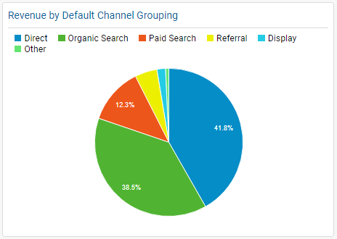
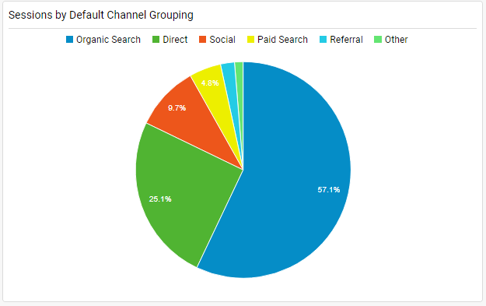
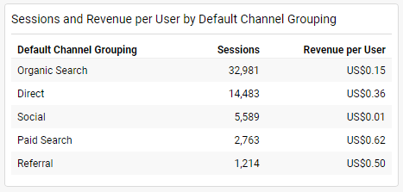
Marketing Dashboard
Insights:
While organic search brings the highest sessions, paid search brings the highest revenue per user.
Paid search and referral have bought the maximum revenue per user which is 4x that of organic Search
Although Direct search is the highest revenue contributor still when we look at Revenue per user it is half of Paid search.
Recommendations:
Target channels with high sessions and implement strategies for increasing the revenue.
Revisit paid ads and look for ways to improve sessions thereby increasing the revenue.
Look for opportunities to grow revenue via social since it generates high sessions.
Business impact:
Create more effective paid ads
Reach more users via targeted ads

Slide 6
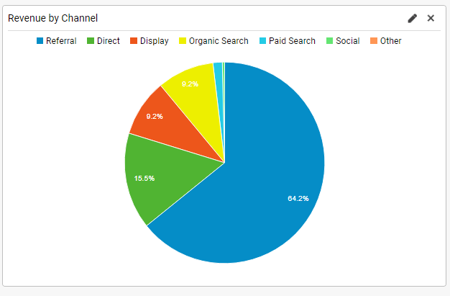
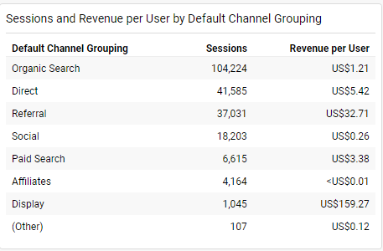
Marketing Dashboard
Recommendations:
Target channels with high sessions and implement strategies for increasing the revenue per user.
Focus on display ads to increase its session thereby increasing revenue.
Look for opportunities to grow revenue via referral and social since it generates high sessions.
Business impact
Create more effective display ads
Reach more users via targeted ads.
Insights
While organic search brings the highest sessions, display brings the highest revenue per user.
65% of Total Revenue is generated by referral but its revenue per user is relatively less when compared to Display ads.

Slide 7
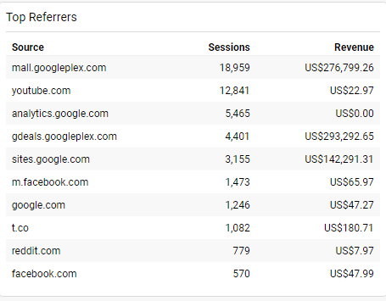
Marketing Dashboard
Insights:
Gdeals has highest revenue in spite of it’s session being 25% of mail.
While YouTube ranks second in terms of sessions, it has one of the lowest revenues.
Recommendations:
Implement strategies that will generate revenue from sources that have high sessions.
Focus on Facebook to increase its session considering it brings significant amount of revenue.
Target sources that have high revenues, study the strategy implemented and tailor it for other sources as well.
Business impact:
By targeting other sources, the company will be able to increase traffic and possibly increase revenue

Slide 8
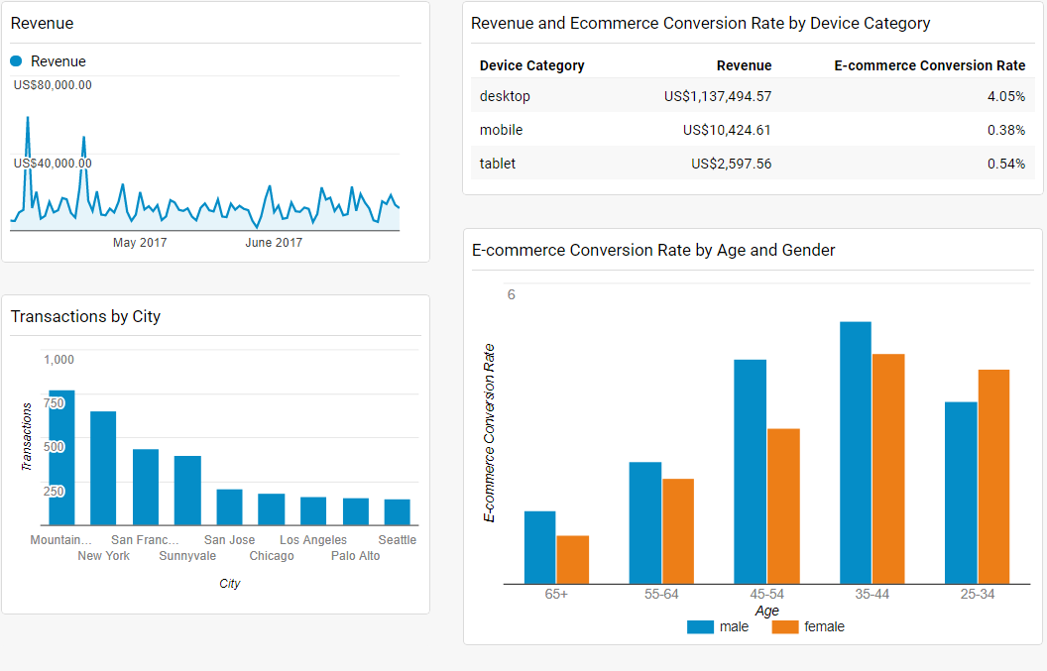
Marketing Dashboard
Insights:
Males between the age of 35-44 have the highest conversion rate at 5.25%, while females in the same group have the highest conversion rate of 4.61%
The highest revenue and e-commerce conversion rate is from desktop users
Mountain view city has the highest transactions at 769
Recommendations:
Target buyers above 55 by developing products and by using the right advertising type and channels to promote the product.
Run region-specific ad campaigns to increase revenue from potential cities
Business impact:
By targeting age group above 55+ the company will introduce a new range of products.

Slide 9
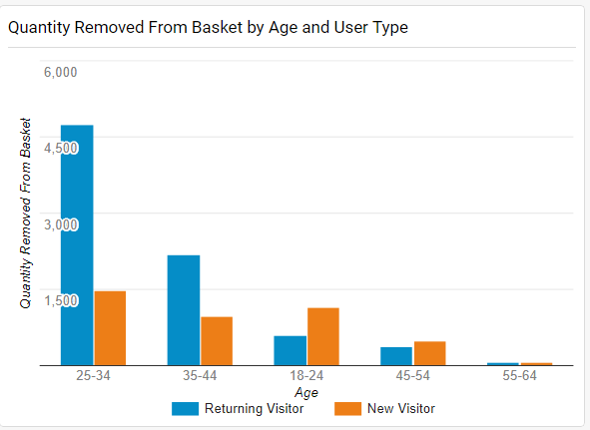
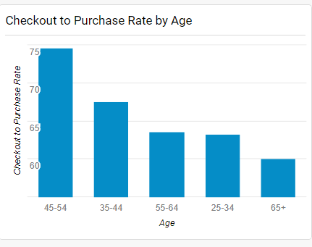
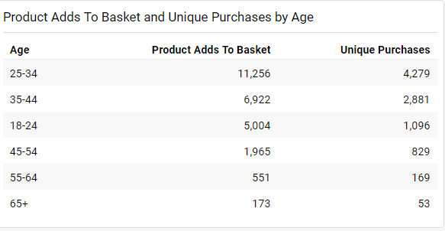
Product Management
Insights:
Users between 25-34 add the maximum products to the basket but do not complete purchases.
Returning users between the age of 25-34 removed a significant number of products from the cart this quarter.
The checkout to purchase rate is the highest between 45-54
Recommendations
For age group of 25-34, review products that are lying in their basket as well as
products removed from their basket.
For age group of 65+, review the checkout to purchase rate.
Business impact
By reviewing products that users are abandoning or removing from cart, the company may be able to understand that the product is not meeting user needs.
The company can also understand whether their checkout process is user-friendly.

Slide 10
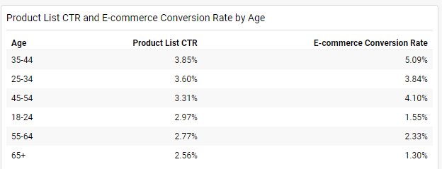
Product Management
Insights:
For age group of 35-44, the CTR and conversion rate is higher, followed by the age group of 45-54.
Recommendations
Focus on the age group of 18-24 and 65+ to improve the conversion rate since they have a decent CTR.
Business impact
By targeting the right age groups, we can increase the sales and revenue in the next quarter.

Slide 11
Thank you

